Slide 1

EBA3500 Data Analysis with Programming
Lecture 1 Teachers: Jonas Moss (jonas.moss@bi.no)
Maximilian Schröder (maximilian.schroder@bi.no)

Slide 2
Outline
What's the course about?
What's the structure of the course?
A refresher on linear algebra.

Slide 3

What's this course about?

Slide 4
Linear regression (in Python)
Backbone of statistics and data science
Science (statistics) and applications (machine learning)
Used in 90% of quantitative papers
Sufficient for most business applications too

Slide 5
Science – Statistics
“There is a positive relationship between income and education level, even when correcting for intelligence.”
Essential for all social science, e.g. economics.
What does this mean?
“Increasing the SAT score by 200 increases yearly expected income by $21,000.
Can we be reasonably sure that a relationship is real, and not just an artifact?
p-values
Confidence intervals
Inference
How do you typically do this kind of thing?
Interpretation

Slide 6
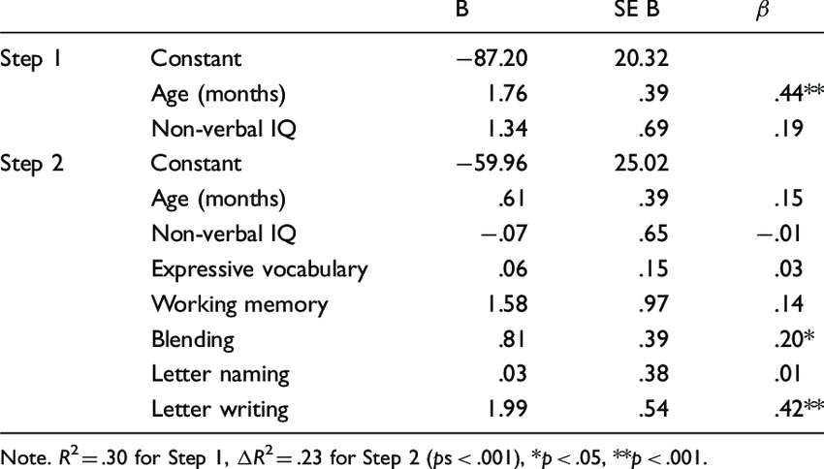
Regression tables
Learn to read such tables!
Necessary for scientific literacy.
Source: Milburn, T. F., Hipfner-Boucher, K., Weitzman, E., Greenberg, J., Pelletier, J., & Girolametto, L. (2017). Cognitive, linguistic and print-related predictors of preschool children’s word spelling and name writing. Journal of Early Childhood Literacy, 17(1), 111–136. https://doi.org/10.1177/1468798415624482

Slide 7

Dry. Difficult. But important!

Slide 8
Why linear regression in machine learning?
Speed
Memory use
Ease of interpretation
Extensibility

Slide 9
Applications – Machine learning
“Predict the price of a stock in 6 months from now, on the basis of company performance measures and economic data.”
“Estimate the amount of glucose in the blood of a diabetic person, from the infrared absorption spectrum of that person’s blood.”
Emphasis on predictions, practicality, usefulness.

Slide 10
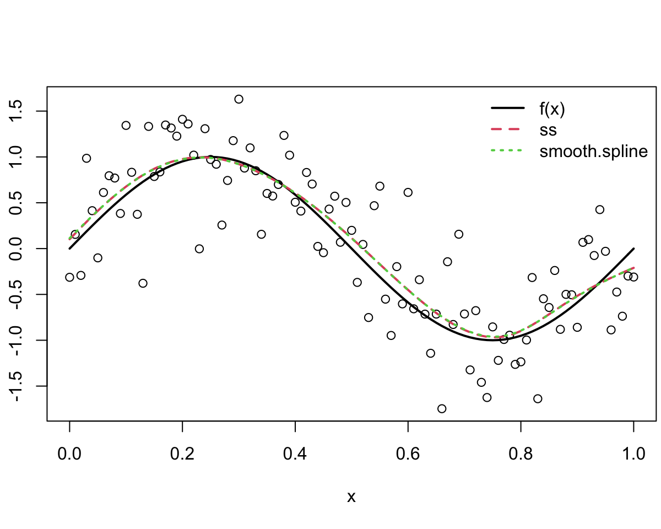
Model complex relationships

Slide 11

Fun fun fun!

Slide 12

What's the structure of the course?

Slide 13

“Statistics is an art as well a science.” - Cliché G. Enerator

Slide 14

Cultivate the sprout of statistics within you!

Slide 15
Plan
Thursdays (10:00)
Lecture, lecture notes, and exercises.
Tuesdays (13:00 – 14:45)
Live exercise session for last weeks exercises.
Wednesdays
Solutions to the exercises.

Slide 16

Feedback!

Slide 17

Work on the exercises!

Slide 18

A refresher on linear algebra

